Slide 1

Supply Chain Management
- By Hiren Mistry

Slide 2

Supply Chain Management
Supply Chain Management is the strategic management of activities involved in the acquisition and conversion of materials to finished products delivered to the customer
Planning, organizing, directing, & controlling flows of materials
  Begins with raw materials
  Continues through internal operations
  Ends with distribution of finished goods
Objective: Maximize value & lower waste
Vidyabharti Trust College of BBA & BCA

Slide 3
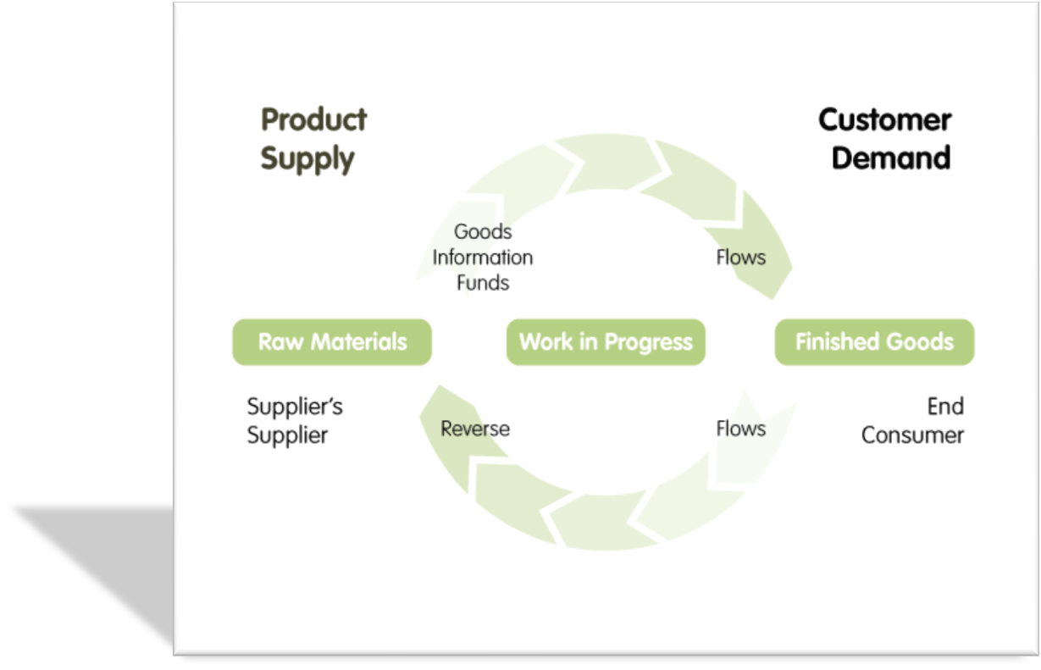
The functional Cycle of SCM
Vidyabharti Trust College of BBA & BCA

Slide 4
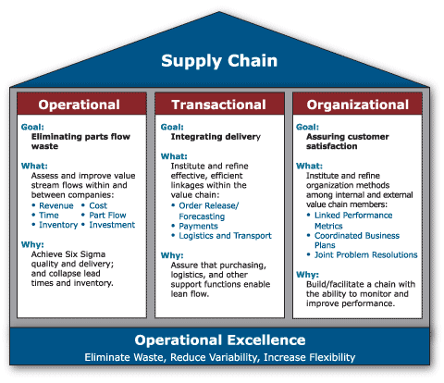
The Scenario
Vidyabharti Trust College of BBA & BCA

Slide 5
Supply Chain Elements
Supply Chain Design
Resource Acquisition
Long Term Planning (1 Year ++)
Strategic
Production/ Distribution Planning
Resource Allocation
Medium Term Planning (Quarterly, Monthly)
Tactical
Shipment Scheduling
Resource Scheduling
Short Term Planning (Weekly, Daily)
Operational
Vidyabharti Trust College of BBA & BCA

Slide 6
SCM Cycle
Supply chain is the system by which organizations source, make and deliver their products or services according to market demand.
Supplier
Material Flow
Customer
Management
Information Flow
Management
Schedule /
Stock
Resources
Conversion
Delivery
Deployment
Vidyabharti Trust College of BBA & BCA

Slide 7


Supply Chain Goals
Efficient supply chain management must result in tangible business improvements. It is characterized by a sharp focus on
  Revenue growth
  Better asset utilization
  Cost reduction.
Vidyabharti Trust College of BBA & BCA

Slide 8
SCM Principles
Compression (Planning/Manufacturing/Supply)
Conformance (Forecasts/Plans/Distribution)
Co-operation (Cross -Functional)
Communication (Real Time Data)
C
Vidyabharti Trust College of BBA & BCA

Slide 9
Thank You!

